Slide 1
CAD model to line art drawing
PACCV – Flow Sensor Assembly Diagrams

Slide 2
Simplifying Line Art
Simplification of technical drawings for a non-engineer audience
Engineering drawings often include fine details like small elements, dashed hidden lines, center lines, and annotations.
Remove extraneous lines/elements to improve appearance of artwork for use in print material and readability.

Slide 3
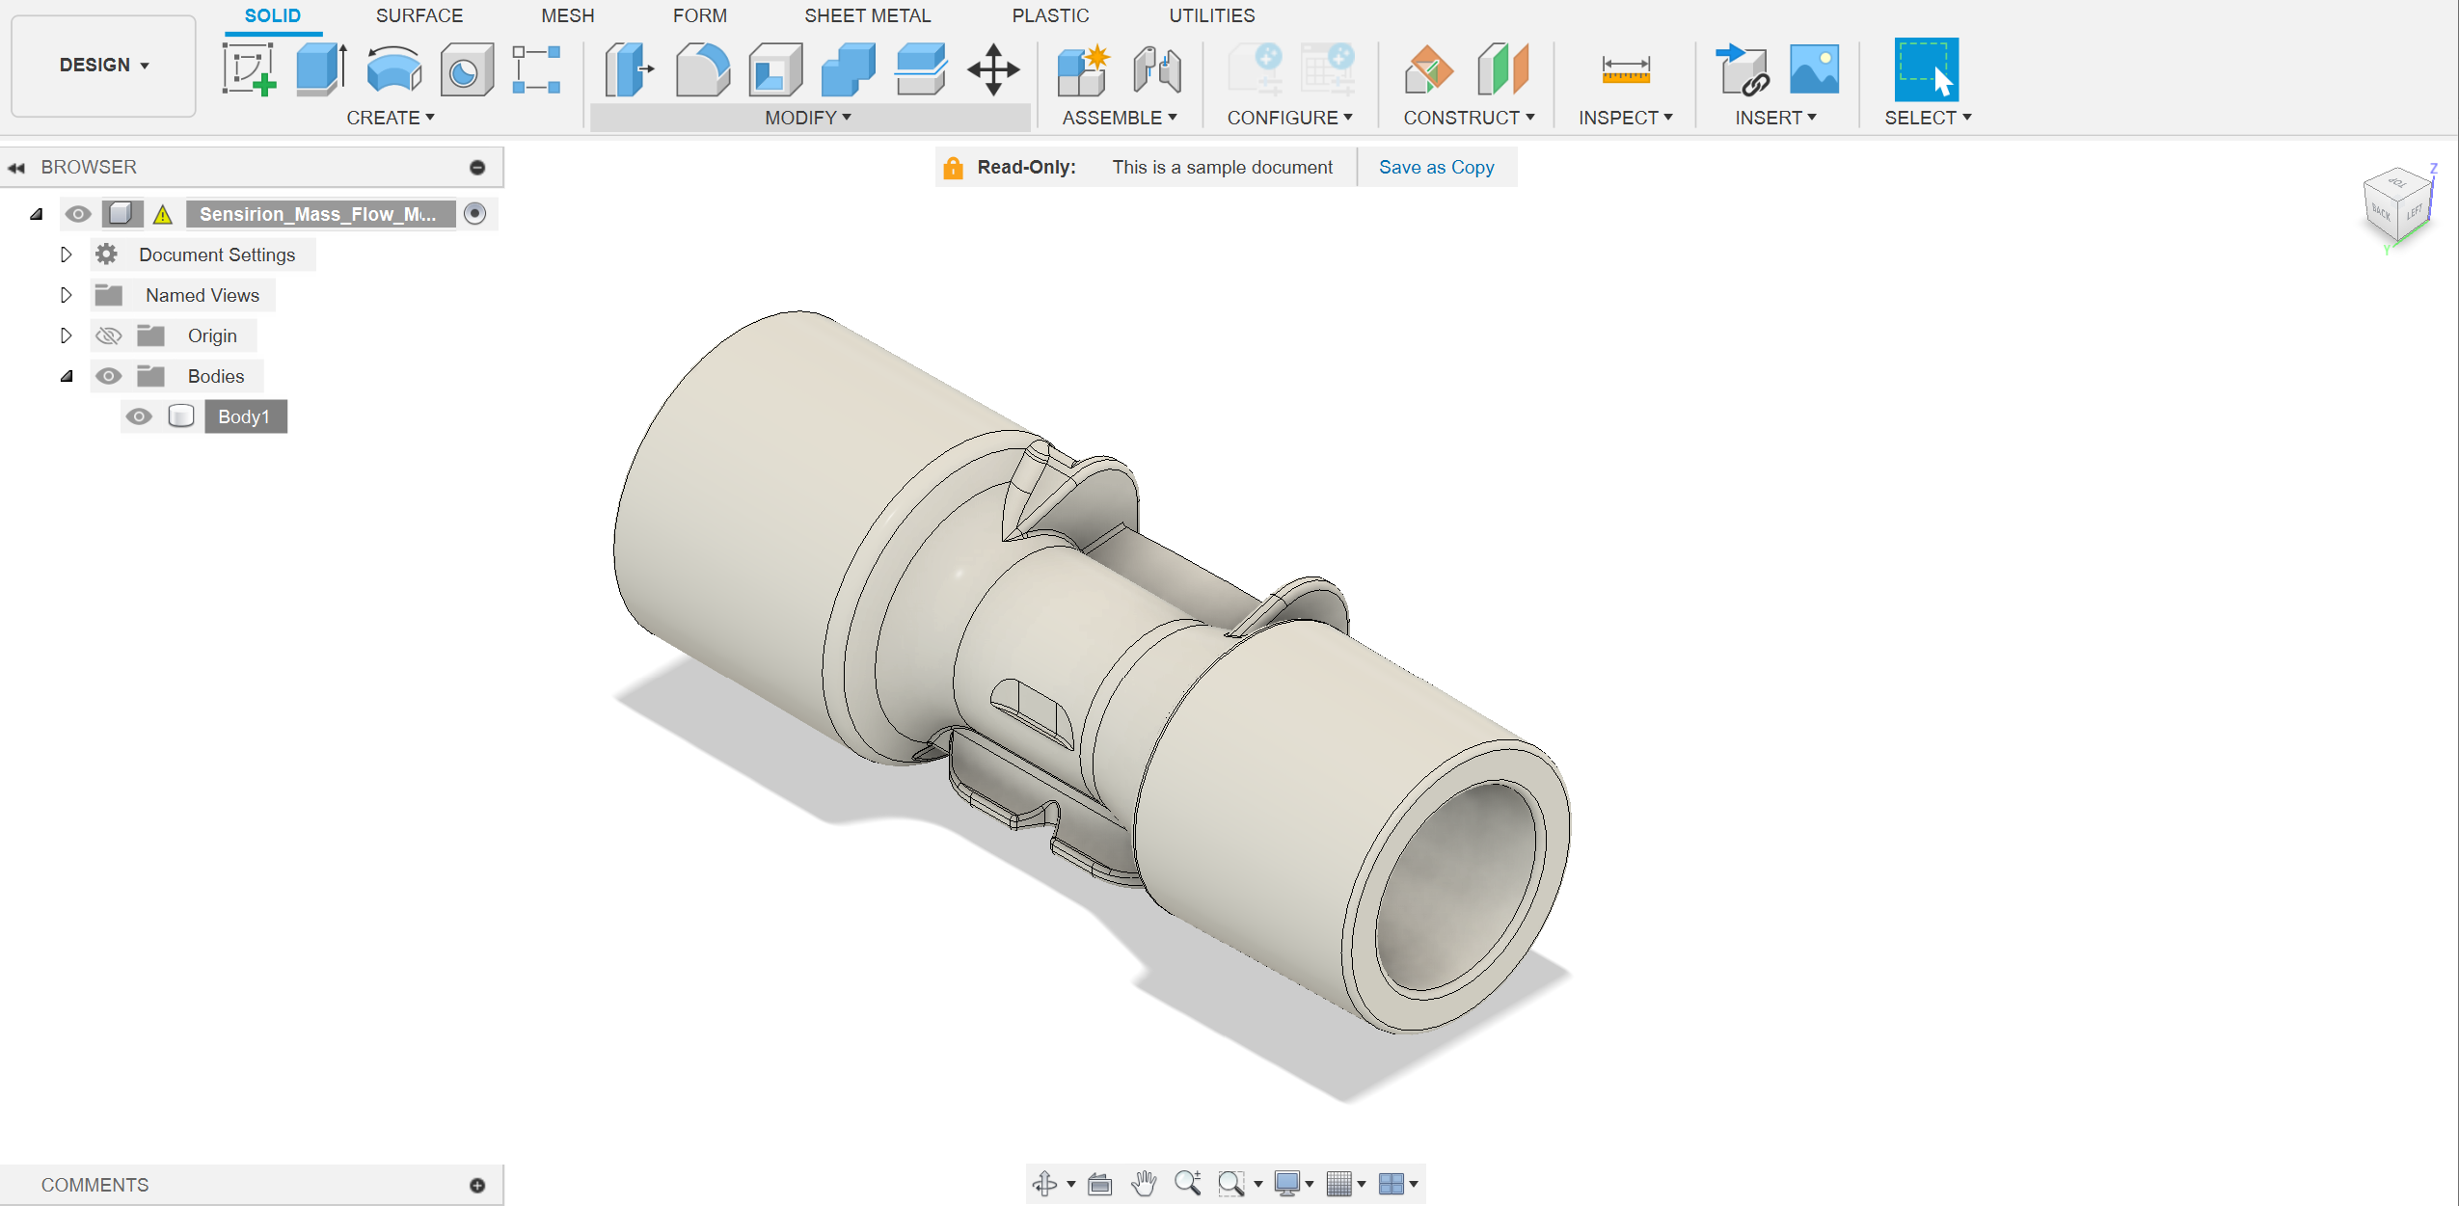
Import CAD file into Fusion360

Slide 4
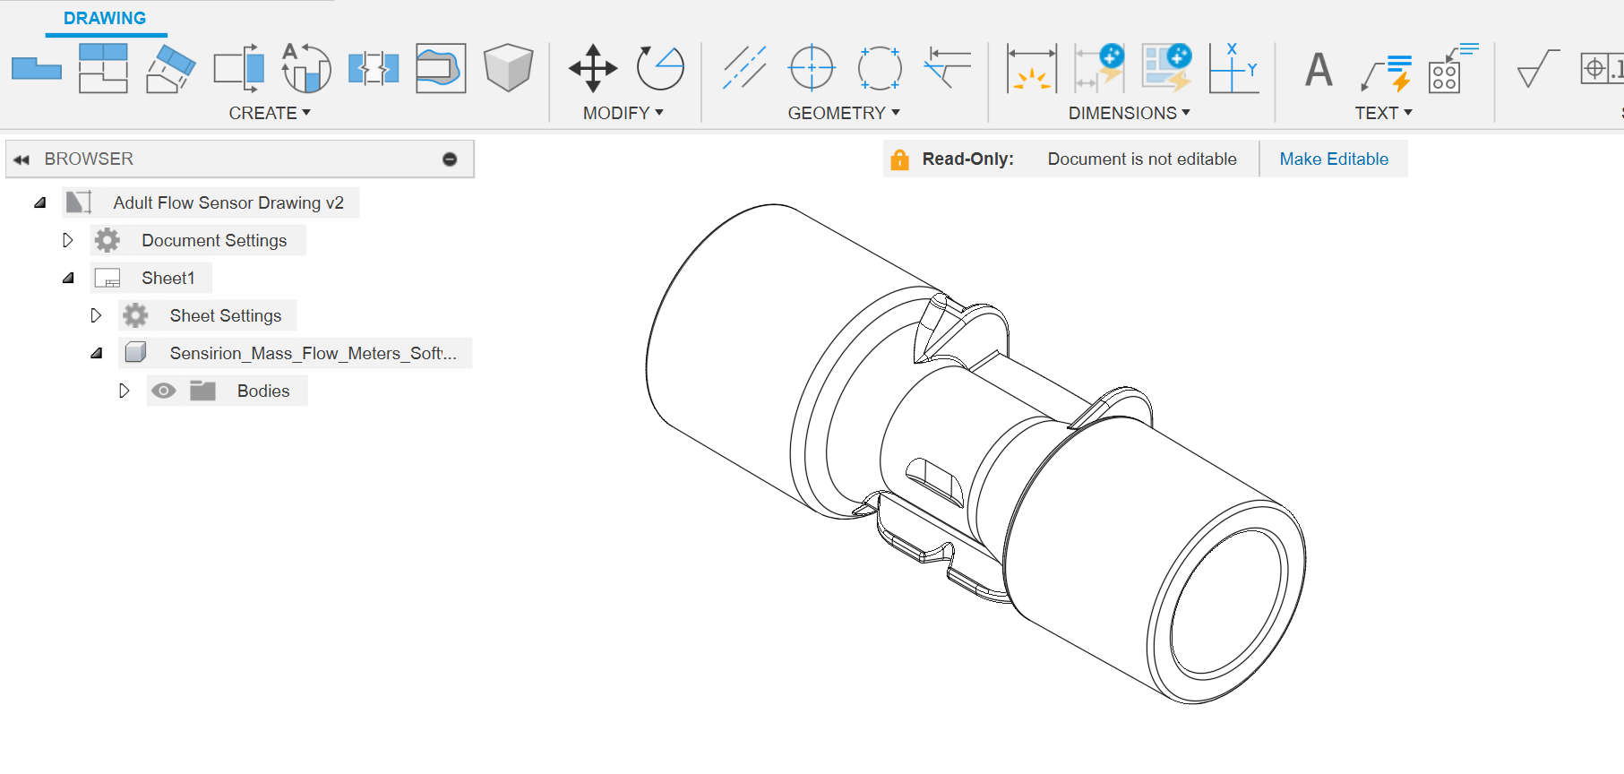
Use CAD model to create engineering drawing
Line art created from 3D object in Fusion360
Output as PDF
Import PDF into Illustrator

Slide 5
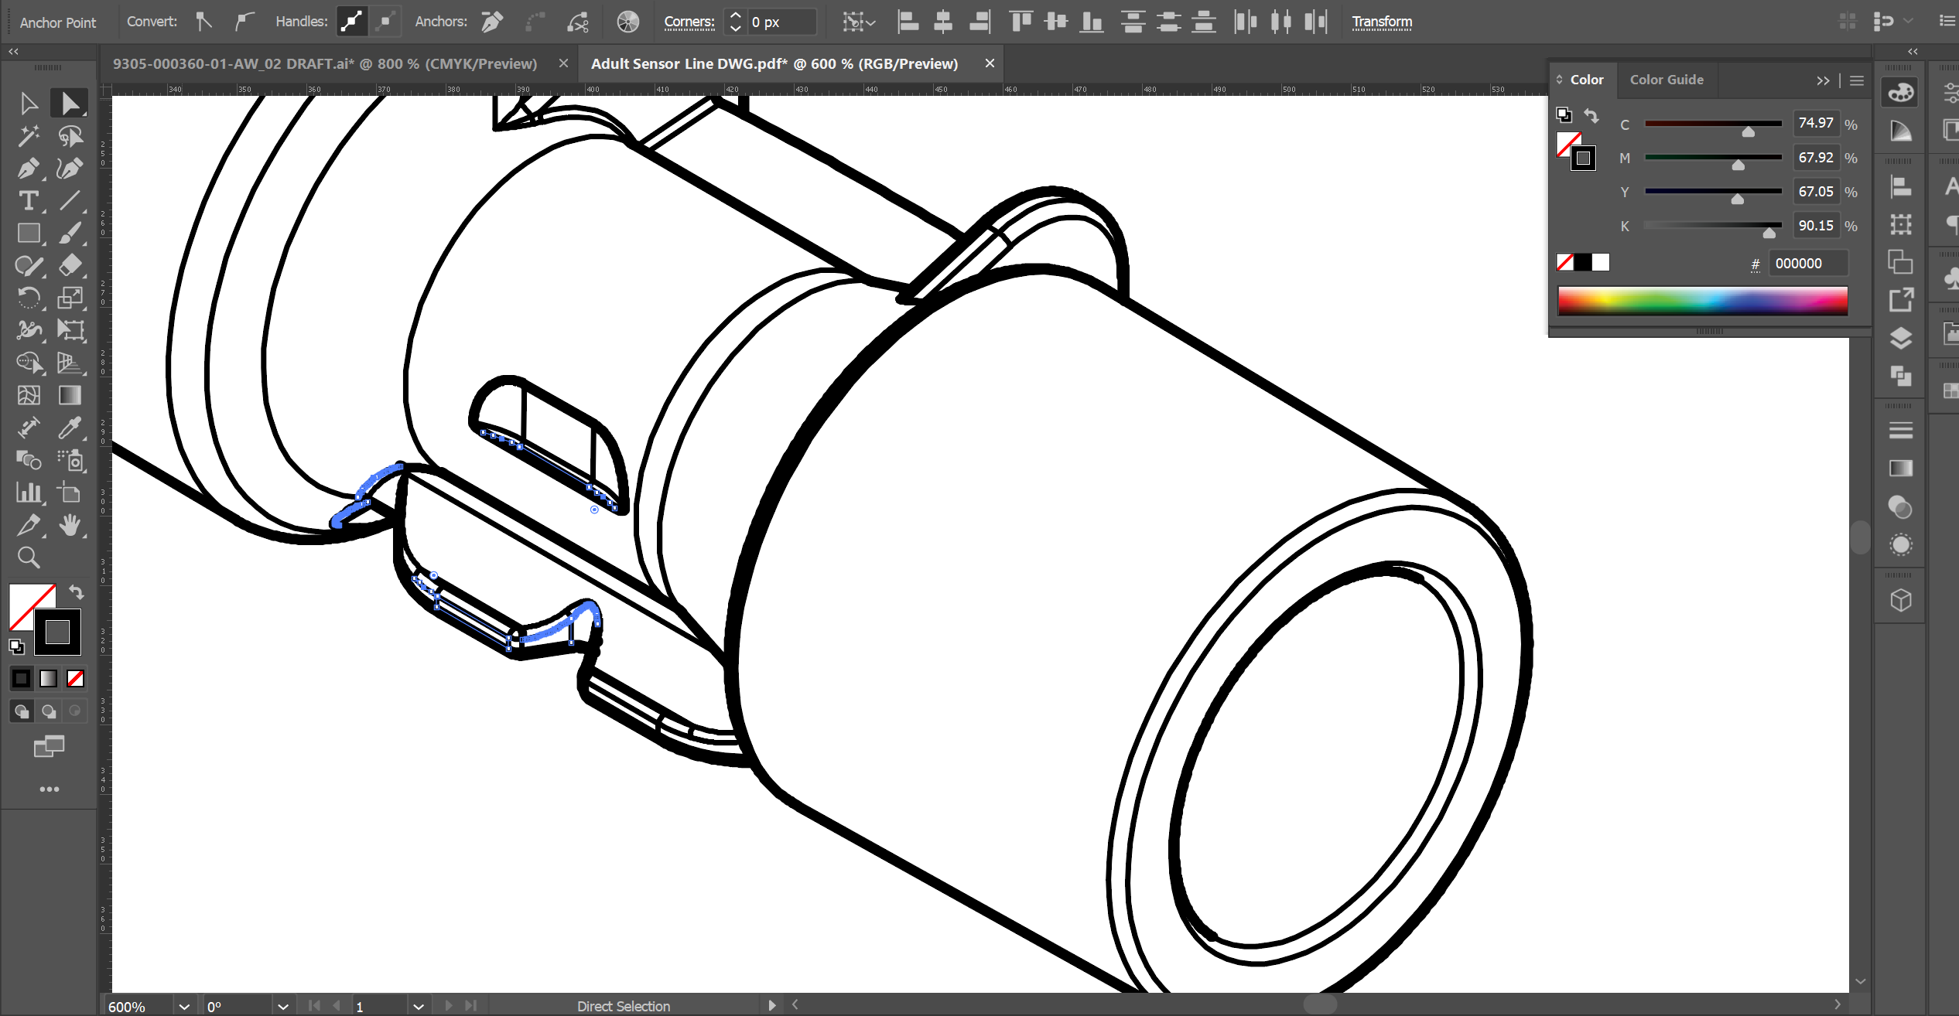
Remove extra detailing/lines with Illustrator

Slide 6
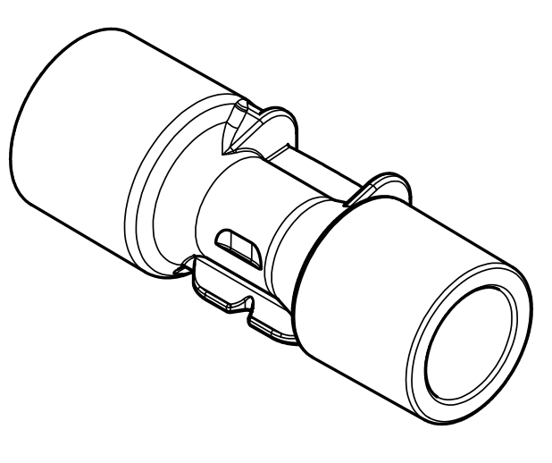
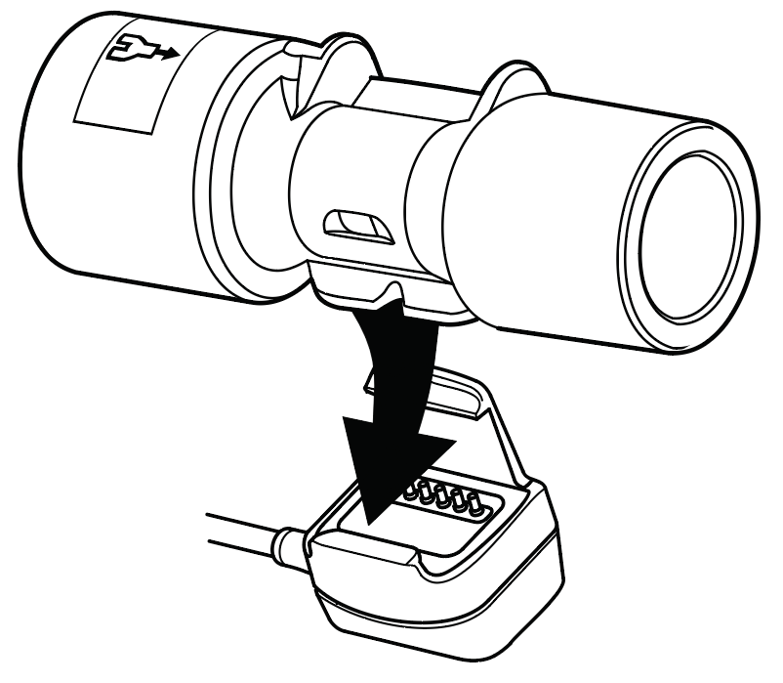
Remove extra detailing/lines with Illustrator

Slide 7
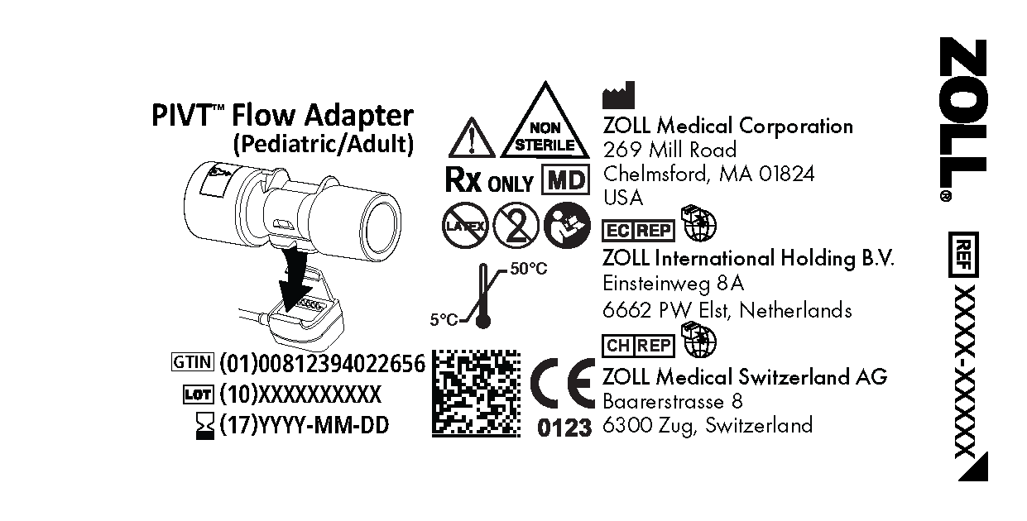
Implement drawing in labeling (9305-000360-01-AW)

Slide 8
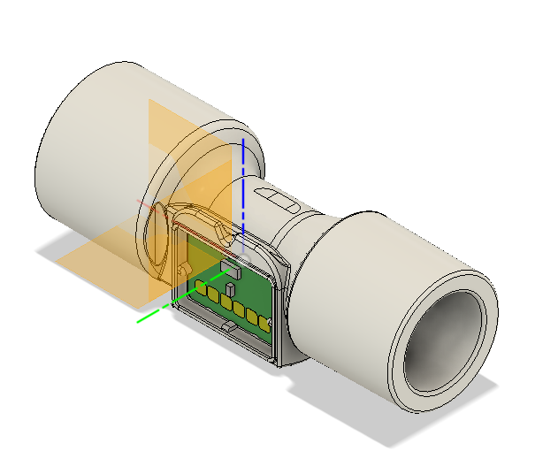
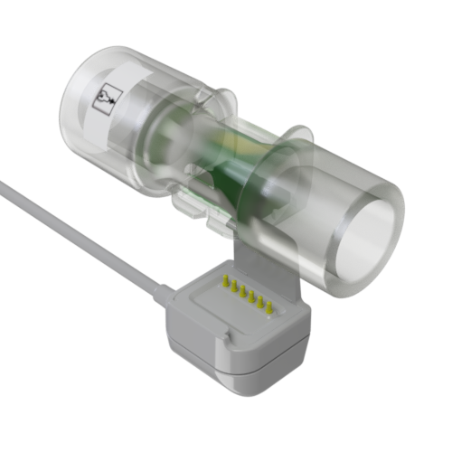
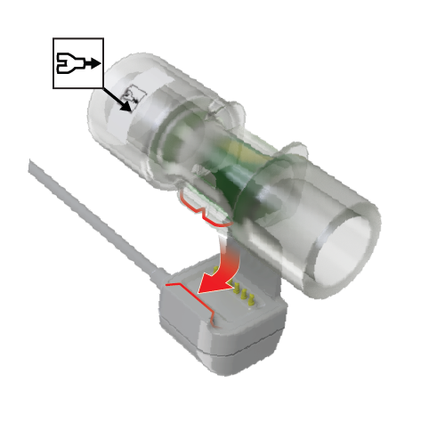
Alt. Rendering Workflow
Acquire CAD model (.sldprt, .step, or .sldasm)
3D texturing and rendering model into an image (PNG w/ transparent background)
Editing image and adding callouts
Notes:
ME has a separate server where CAD models are saved, not in Agile. Will need to ask one of the engineers to send over a copy.

